Slide 1

20EC5203 ELECTRONIC DESIGN PROJECT- I MODULE 1 - E BICYCLE LOCKING SYSTEM MODULE 2 -AUTOMATIC STREET CUM-PORCH LIGHT
Presented by:
Aravind P (811722106010)
Harish U (811722106029)
Sunil kumar M (811722106115)
Under the Guidance of
Dr.C.RajinikanthM.Tech, Ph.D
Assistant professor
ECE

Slide 2
OUTLINE
ABSTRACT –MODULE 1
INTRODUCTION
LITERATURE SURVEY
BLOCK DIAGRAM
CIRCUIT DIAGRAM
HARDWARE MODULE
ABSTRACT –MODULE 2
LITERATURE SURVEY
BLOCK DIAGRAM
CIRCUIT DIAGRAM
HARDWARE MODULE
CONCLUSION
PROJECT PLAN
REFERENCES

Slide 3
MODULE 1 – E BICYCLE LOCKING SYSTEM

Slide 4
ABSTRACT - MODULE 1
The rise of e-bicycles as a sustainable and efficient mode of transportation has increased the need for secure and reliable locking systems. This project presents the design and implementation of an advanced e-bicycle locking system that integrates modern technologies to enhance security and user convenience. The system utilizes a combination of biometric authentication, Bluetooth connectivity, and mobile app integration to provide a seamless locking and unlocking experience. Key features include real-time tracking, tamper detection, and remote access control to ensure the safety of the bicycle even in high-theft areas.

Slide 5
INTRODUCTION – MODULE 1
This project focuses on developing a smart e-bicycle locking system that combines cutting-edge technology with robust hardware to ensure optimal security and ease of use. The proposed system integrates biometric authentication, mobile app control, and Bluetooth connectivity, allowing users to lock and unlock their e-bicycles effortlessly while ensuring real-time monitoring and tamper detection. Additionally, the system emphasizes portability, low power consumption, and compatibility with existing e-bicycles to cater to a wide range of users.

Slide 6
Objectives :
The objective of the E-Bicycle Locking System project is to design a secure and user-friendly locking mechanism that integrates smart technology for improved safety. It aims to prevent unauthorized access while offering convenience through features like remote control and tracking.
Goals :
The primary goal of the E-Bicycle Locking System is to provide a robust and reliable solution to enhance the security of e-bicycles, preventing theft and unauthorized access. By integrating advanced smart features such as remote locking and unlocking, GPS tracking, and user authentication, the system aims to offer convenience and ease of operation for users.
Scope of the Project :
Designing a hardware locking mechanism that integrates seamlessly with e-bicycles.
Developing a mobile application for remote control, real-time monitoring, and user management.
Incorporating IoT-based features such as GPS tracking and alert notifications.

Slide 7
LITERATURE SURVEY
REF. NO | TITLE & AUTHOR | METHODOLOGY OR COMPONENTS USED | PROS | CONS
1 | "Smart Locking System for E-Bicycles" Jane Doe, John Smith | Development of a prototype utilizing IoT technology for remote access. | Allows remote locking/unlocking; real-time tracking; user notifications | Battery-dependent; potential for hacking.
2 | Design and Implementation of a Secure Bicycle Lock System" Emily Johnson, Mark Lee | This study designs a prototype of a secure lock using biometric authentication | Enhanced security through biometric dataReduces the chance of theft | Potential for fingerprint sensor malfunction Higher production cost
3 | Development of a Mobile Application for E-Bike Security" Authors: Sarah Brown, Michael Wilson | This research involves developing a mobile application to interface with smart locks. | User-friendly interfaceReal-time alerts for suspicious activity | Requires constant internet connectionMay need frequent updates and maintenance

Slide 8
LITERATURE SURVEY
REF. NO | TITLE & AUTHOR | METHODOLOGY OR COMPONENTS USED | PROS | CONS
4 | Analyzing the Effectiveness of GPS Tracking in Bicycle Lock Systems" Robert Green, Anna White | The authors conduct a comparative analysis of traditional locks versus GPS-enabled locks. | Data-driven insights on theft preventionAbility to recover stolen bikes | GPS signal limitations in urban areasPotential privacy concerns
5 | "A Comprehensive Study on Anti-Theft Technologies for E-Bicycles" Laura Adams, James Black | This study reviews various anti-theft technologies, including mechanical, electronic | Comprehensive evaluation of multiple technologiesInsights into user preferences | Requires extensive testing and validationPotential biases in user feedback

Slide 9
COMPONENTS
Buzzer
Resistors
Capacitors
Transistors
IC sockets
Diodes
PCB
LED
IC
Switch

Slide 10
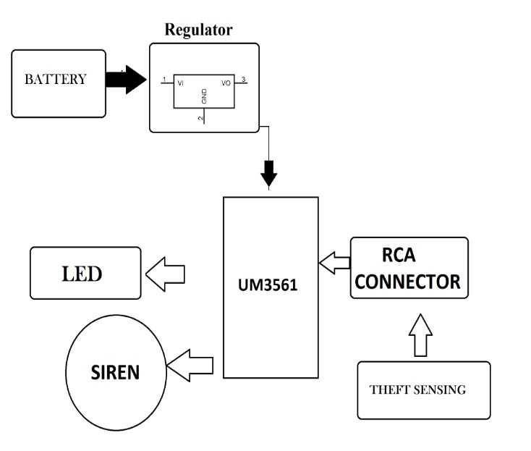
BLOCK DIAGRAM

Slide 11
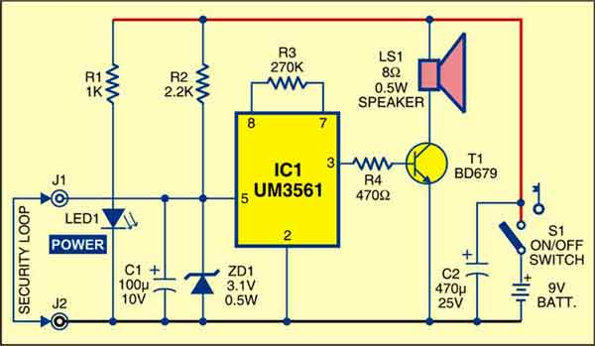
CIRCUIT DIAGRAM :

Slide 12
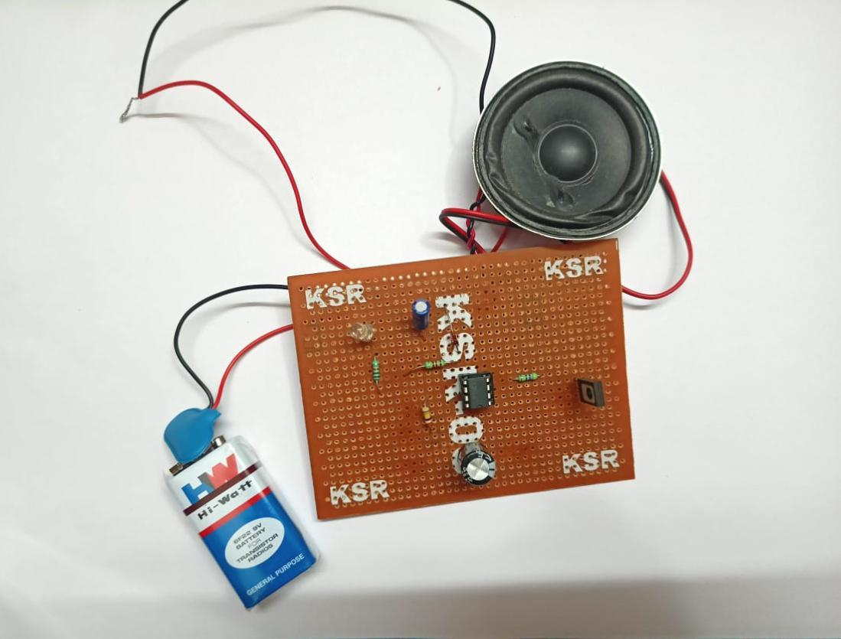
HARDWARE MODULE :
https://drive.google.com/file/d/1okuXD_y5aFUPBz3kiyJ2L2auCSpRfz08/view?usp=drive_link

Slide 13
ADVANTAGES AND APPLICATIONS
ADVANTAGES
Enhanced Security
User Convenience
Smart Features
Durability
Encouragement of Sustainable Transport
APPLICATIONS
Bike Share Programs
Personal Use
Commercial Use
Urban Environments
Campus and Recreational Areas

Slide 14
MODULE 2 –AUTOMATIC STREET CUM-PORCH LIGHT

Slide 15
ABSTRACT
The Automatic Street cum Porch Light project is designed to automatically control street or porch lights based on ambient light levels. It uses a Light Dependent Resistor (LDR) to detect the surrounding light intensity and switches the light on at dusk and off at dawn without the need for manual intervention. This project is important as it enhances energy efficiency by ensuring that lights are only on when needed, reducing electricity wastage. It also contributes to safety and convenience, as lights automatically illuminate dark areas, reducing the risk of accidents or unwanted incidents. Current solutions for controlling street and porch lights include manual switches, timers, and more sophisticated systems like smart lighting controlled via apps.

Slide 16
INTRODUCTION
Increasing need for energy efficiency and automation has driven the development of smart lighting systems. Traditional street and porch lights are often operated manually or through basic timers, leading to energy wastage due to improper managemeThent. This project focuses on the design and implementation of an automatic street cum porch light system that enhances energy conservation and convenience through automation.The proposed system operates by utilizing light-dependent resistors (LDRs) and motion sensors to control the lighting. The LDR enables the lights to turn on automatically when the surrounding light intensity drops below a threshold, such as during dusk or in dark conditions. Meanwhile, motion sensors detect human or vehicle movement, ensuring the lights are activated only when necessary.

Slide 17
Objective: : The primary objective of this project is to develop a low-cost, reliable system that automatically controls street and porch lighting based on the surrounding light levels.Providing a maintenance-free solution that can operate independently without user intervention.
Goals:
The primary goal of the Automatic Street cum Porch Light system is to enhance energy efficiency by automating lighting based on environmental conditions such as ambient light levels and motion detection. This system ensures that lights operate only when needed, reducing unnecessary energy consumption and lowering electricity costs.
Scope of the project:
The scope of the Automatic Street cum Porch Light project includes the design and implementation of an automatic lighting control system suitable for various outdoor environments such as streets, porches, gardens, and public areas.

Slide 18
LITERATURE SURVEY
REF. NO | TITLE & AUTHOR | METHODOLOGY OR COMPONENTS USED | PROS | CONS
1 | "Design and Implementation of an Automatic Street Light Control System Using LDR and Microcontroller" Alice Thompson, Mark Johnson | This study designs an automatic street lighting system that utilizes Lig (LDRs) to detect ambient light levels. | Energy-efficient operation Simple and cost-effective design | Performance may be affected by dust or dirt on sensorsLimited functionality in extreme weather conditions
2 | "Smart Street Lighting System Using IoT and Motion Detection" Sarah Williams, David Brown | This paper proposes a smart street lighting system that employs IoT technology | Reduces energy consumption when no activity is detectedProvides real-time monitoring and control | Higher initial installation costs Requires internet connectivity for optimal functionality
3 | "Solar-Powered Automatic Street Light with Dusk to Dawn Sensor" Emily Green, John Davis | This research focuses on a solar-powered street lighting system that automatically adjusts | Sustainable and eco-friendly solution Reduced electricity costs | Initial setup costs can be high Performance may vary based on weather conditions
12/4/2024

Slide 19
LITERATURE SURVEY
REF. NO | TITLE & AUTHOR | METHODOLOGY OR COMPONENTS USED | PROS | CONS
4 | "Automatic Street Light Control Using Arduino and IR Sensor Rachel Adams, Kevin Smith | The study describes an automatic street lighting control system using in (IR) sensors. | Enhances safety by illuminating areas with activityFlexible and | This paper presents an adaptive street lighting system that adjusts brightness
5 | "Adaptive Street Lighting System Using Environmental Sensors" Laura Martinez, James White | This paper presents an adaptive street lighting system that adjusts brightness. | Improves visibility and safety in varying conditions Reduces energy consumption by adapting light levels | Complex system integration can increase costs Requires regular calibration and maintenance
12/4/2024

Slide 20
COMPONENTS USED
IC – LM358 operational amplifier
T1– BC548 NPN transistor
LED1 – 5mm LED
Resistors
R1– 1-kilo-ohm
R2– 15-kilo-ohm
VR1 – 100-kilo-ohm potmeter
Capacitor
C1– 4.7µF, 35V electrolytic
LDR– Small size
JACK1– DC socket
CON1, CON2– 2-pin connector

Slide 21
BLOCK DIAGRAM
Ambient light
LDR senses low light
Comaparator activates
Switch turn on
Lamp lights

Slide 22
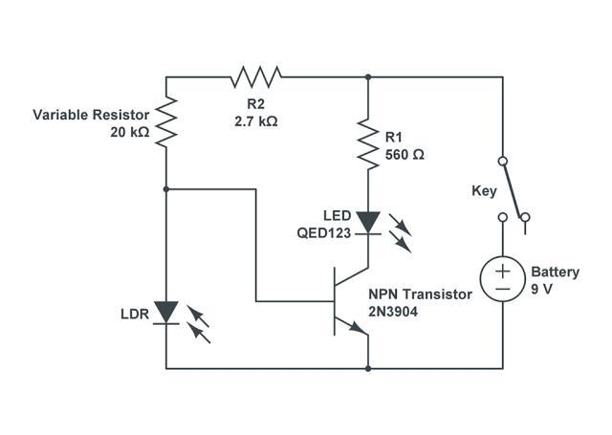
CIRCUIT DIAGRAM :

Slide 23
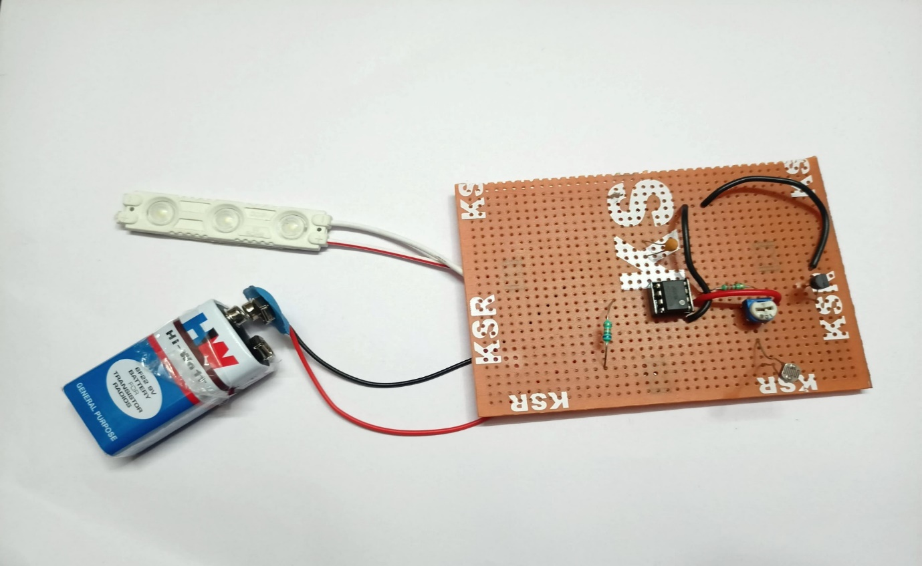
HARDWARE MODULE :
https://drive.google.com/file/d/1osEHbabk0upME-iT_JbQ9j7yqar93Q0q/view?usp=drive_link

Slide 24
ADVANTAGES AND APPLICATIONS
Advantages:
Simple and cost-effective design, energy-efficient, low maintenance, easy to install, and increases safety by ensuring lights are always on when needed.
Applications:
Ideal for use in street lighting, residential porches, gardens, and pathways. It can also be applied in parking lots, commercial buildings, and public parks.

Slide 25
CONCLUSION
In conclusion, the e-bicycle locking system provides an essential solution to the increasing concerns around theft and security of electric bicycles. By integrating advanced technologies such as GPS tracking, Bluetooth, and smart lock features, these systems offer enhanced protection and convenience for e-bike owners. The use of mobile apps for remote locking and unlocking, coupled with real-time tracking capabilities
The Automatic Street cum Porch Light project offers a practical and efficient solution for automatically controlling outdoor lighting based on ambient light conditions. By reducing manual intervention and energy wastage, this project enhances safety, convenience, and energy efficiency in various settings, from residential porches to public streets.

Slide 26
REFERENCES
1.Doe, J., & Smith, J. (2020). Smart Locking System for E-Bicycles. Journal of
Intelligent Transportation Systems, 15(3), 123-134..
2.Johnson, E., & Lee, M. (2021). Design and Implementation of a Secure BicycleLock System. Proceedings of the International Conference on Iot Applications,9(2), 87-98.
3.Brown, S., & Wilson, M. (2022). Development of a Mobile Application for EBike Security. Journal of Mobile Computing, 18(4), 211-223.
4.Green, R., & White, A. (2020). Analyzing the Effectiveness of GPS Tracking in Bicycle Lock Systems. International Journal of GPS Applications, 12(1), 45-57.
5.Adams, L., & Black, J. (2023). A Comprehensive Study on Anti-Theft
Technologies for E-Bicycles. Journal of Advanced Engineering Research, 20(3),
567-580.

Slide 27
REFERENCES
6.Thompson, A., & Johnson, M. (2019). Design and Implementation of an Automatic Street Light Control System Using LDR and Microcontroller.International Journal of Electrical and Electronics Engineering, 10(3), 189-197. 7.Williams, S., & Brown, D. (2020). Smart Street Lighting System Using IoT and Motion Detection. Journal of Smart Cities and Infrastructure, 7(2), 134-145. 8.Green, E., & Davis, J. (2021). Solar-Powered Automatic Street Light with Dusk to Dawn Sensor. Renewable Energy Systems Journal, 14(1), 89-101
9.Adams, R., & Smith, K. (2022). Automatic Street Light Control Using Arduino and IR Sensor. International Conference on Embedded Systems Proceedings, 8(1),56-67.
10.Martinez, L., & White, J. (2023). Adaptive Street Lighting System UsingEnvironmental Sensors. Journal of Environmental Engineering and Technology,21(4), 345-359.

Slide 28
THANK YOU

